Slide 1
What not to do in a contest
Trent Sampson
WIA Director for Awards and Contests

Slide 2
#1 Don’t read the rules
Contest managers change rules regularly
Obtain extra info on how to read them
Talk to contesters
VKCC Forum is one of the best
Watch out for the jargon

Slide 3
Jargon
SO2R | Single Operator Two Radio
Multi Op | Multiple Operators
SOAB | Single Operator All Band
Mult | Multiplier
Dupe | Duplicate Contact
Rate | Contacts over a period

Slide 4
Rules Change example
2011 CQ WPX
2012 CQ WPX
Multi Single was one transmitter
However one other transmitter could be used on another band if the contact(s) was with a new multiplier
Multi Single is one transmitter
No other transmitters can be used.
Seen as a dumbing down by many

Slide 5
WPX Changes
No longer a need for “better technology”
Filtering ,TX lockouts not needed
Makes the contest purely a rate chase
Switch to the band with the highest rates into stronger areas and continue to build multipliers
Concentrate USA JA fast ops lots of multipliers

Slide 6
Multipliers – How they work
QSO | Band | Band Points | Multiplier | QXBPXM
50 | 80 | 3 | 20 | 3000
100 | 40 | 2 | 20 | 4000
250 | 20 | 1 | 20 | 5000
250 | 15 | 2 | 20 | 10000
250 | 10 | 3 | 20 | 15000
 |  |  |  | 37000

Slide 7
#2 Only have one antenna option
Less confusing
Easier to workout band changes
Saves mucking around working lots of stations
Keeps everything under control

Slide 8
Terrain Analysis
Note: low take off angles missed by Red Curve

Slide 9
Simple VK Contest Weapon
Thinking 80M
How do you cover all of VK ?
How do you do it consistently ?
Is there a better way ?
Where is the best location ?

Slide 10
Coax Phasing Network
Simple to build
Coax Switch
3 Coax Tees
2 X ¼ wavelength 70 ohm
1 X ¼ wavelength 50 ohm
Transmitter always sees 50 ohms with 1 or both antennas
Single band only
More details at www.w9xt.com
Notes:
Normally used to stack mono-band Yagis. L1, L2 must be same length
Can be used with different antenna types, L1, L2 any length

Slide 11
Phasing Network

Slide 12
Two special cases are at work here. A ¼ λ feed line will convert an open circuit on one end to a short circuit at the other. The inverse is true, and a short circuit on one end will appear as an open circuit at the other end. The other special case is that a ¼ λ 70 Ω coax will transform 50 Ω on one end to 100 Ω on the other.
Looking at the diagram, the switch is in the center position. In this position, both antennas will be connected. Antenna 1 will present a 50 Ω load at Tee connector A. The 70 Ω coax between connectors A and B will transform the 50 Ω to 100 Ω at connector B. Similarly, the impedance from Antenna 2 will also appear as 100 Ω at connector B. The two 100 Ω impedances in parallel form 50 Ω which is preserved through the 50 Ω coax back to the switch and to the transmitter

Slide 13
VK Contests v International
VK
Others
Tend not to use multipliers
Slower paced ease into
Band changes nice
Casual exchange “g’day Fred” “morning Ralph”
Repeat contacts allowed
Multipliers
Face paced, expect pileups
Band changes critical
Exchange brief Report and go
No repeat contacts

Slide 14
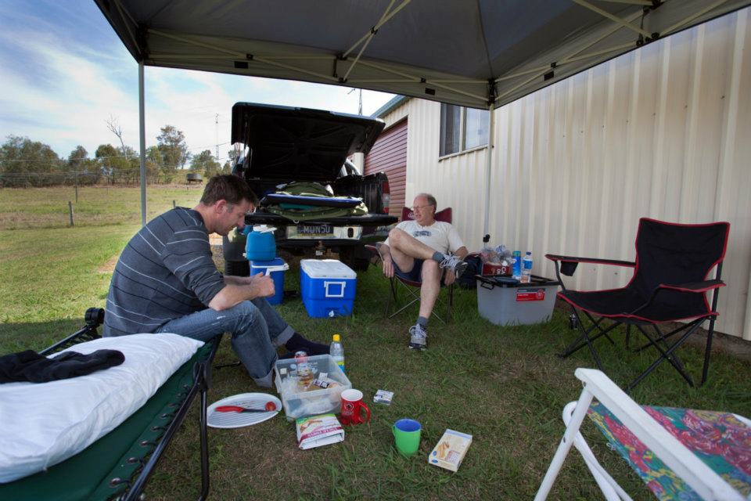
VK4SN and VK4NDX

Slide 15
Software
Writelog – CW Decoder ,SSB,CW,RTTY
N1MM-SSB,CW,RTTY –Does VK (VK4SN)
Win Test – QSY Wizard super
VKCL – VK Contests very well Keyer options
RTTY (different strokes) MMTTY RTTY

Slide 16
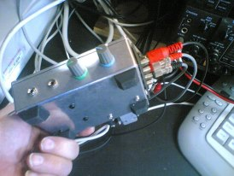
Simple Interfaces
RS232 DTR or RTS Lines, Audio in out, PTT Jaycar Microphone preamp kit to suit Heil

Slide 17
Complicated Interfaces

Slide 18
MK2R+

Slide 19
Go Portable VK4NM@StGeorge QLD

Slide 20
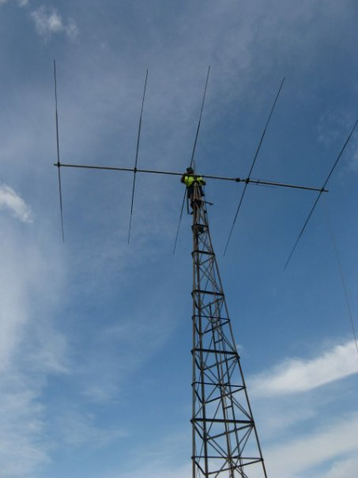
VK4TS 15M Yagi

Slide 21
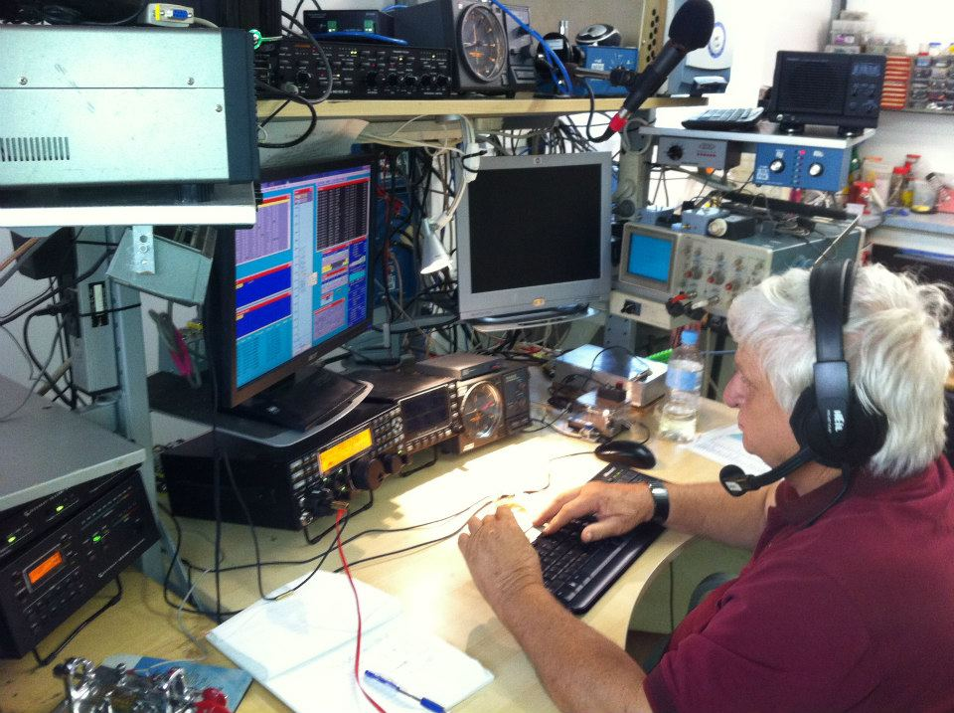
VK4UC
John VK4UC Heil Headset Micro-ham interface,K3, K500 Amp, Win-test, Six Pack
2 element Force 12 40M Beam 6M length Chromolly C31XR Tri-bander, Rippletech Sloper for 160/80

Slide 22
#3 Operating
Talk as fast as you can
Never repeat your call-sign
Call every one over a wide spread
Never repeat your report for anyone
Never confirm the other call

Slide 23
best of the best
480 VP2E N5TJ CQWWSSB2004 (qrate hour) update:2004-11-08 480 VP2KC JA3ODC CQWWSSB1979 update:2010-04-20 464 VP2E N5TJ CQWWSSB2003 (qrate hour) 460 WP3R K9PG ARRLSSB 2003 (qrate hour) 457 P40L N5TJ CQWWSSB 1993 430 ZF2MM K9PG ARRLSSB 2002 (qrate hour) 422 8P1A W2SC CQWWSSB 2003 (clock hour) 417 PJ2T K1AR CQWWSSB 2003 (clock hour) 409 ZF2NT K9PG ARRLSSB 2001 (qrate hour) 394 RC0F RC0F CQWWSSB 2011 (clock hour) update:2011-11-01 393 8P8P NN1N CQWWSSB 2002 (qrate hour, 10m) update:2004-08-31 392 NP4A K5ZD CQWWSSB 1981 (qrate hour)

Slide 24
K9PG
gives his call-sign very regularly
Confirms the other calls
Is very brief
Can handle multiple calls
Different for intra VK Contests
Only in terms of not being brief

Slide 25
#4 Setting up
Disable ALC
Increase Processor to +40
Warn the neighbours of severe solar electrical storm that will cause TV / stereo interference
Increase mike gain to the stopper
Send family away for weekend

Slide 26
Best Practices
Read rules and under stand them
Align the rig and amps to manufacturer specs
Find the best location
Match antenna to location
Use Software for contest
Use Voice Keyers or CW keyers to reduce tiredness
Use a comfortable operating position

Slide 27
Join the VKCC (free)
Come to the Dinner tonight
Enjoy today
Enter the next contest

Slide 28
QUESTIONS

Slide 29
Thank you

