Slide 1
World Wide Flora & Fauna (WWFF)

Slide 2
About WWFF
Commenced 2008 as WFF
Initiated by the Russian Robinson Club
Relaunched as WWFF in late 2012
draw attention to the importance of protecting nature, flora & fauna
Operate from designated nature parks/ protected nature areas

Slide 3
About WWFF
National & non-commercial program
Run by the co-ordinators of a large number of Flora & Fauna programs.
WWFF Council
Chairman, Vice chairman, Council members
38 participating countries
National programs
Various National Awards offered.
Global award program

Slide 4
About WWFF
GLOBAL Awards
44 QSO’s required
2 hour operating time.

Slide 5
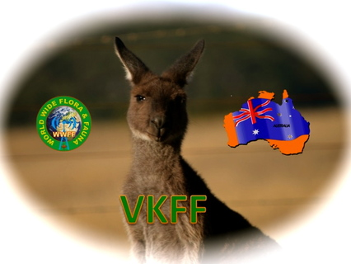
Australian (VKFF) program
Commenced March 2013
VK5PAS – Australian co-ordinator
VKFF National Awards.
Slightly different rules

Slide 6
Australian (VKFF) program
Open to…..
Activators
Hunters
SWL’s.

Slide 7
Australian (VKFF) program
National Parks
10 QSO’s required
30 minute operating time.
Certificates
Free as PDF or JPG
$5.00 printed & posted

Slide 8
Australian (VKFF) program
31 overseas recipients.
7 Australian activator certificates
20 Australian Hunter certificates

Slide 9
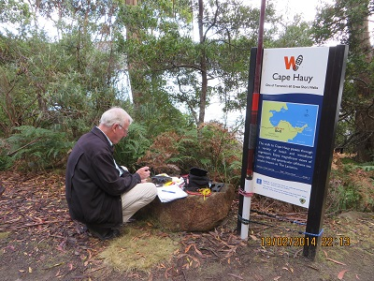
Australian (VKFF) program
Activators
Bronze
10 VKFF
Silver
20 VKFF
Gold
30 VKFF
Platinum
40 VKFF
Diamond
50 VKFF

Slide 10
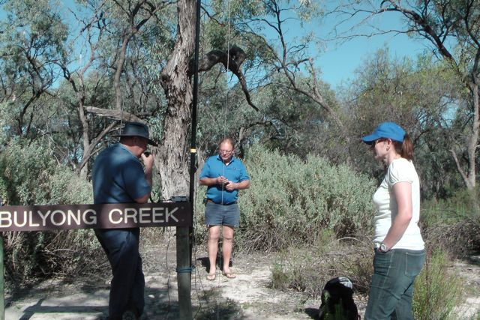
Australian (VKFF) program
Hunters & SWL’s
Bronze
10 VKFF
Silver
20 VKFF
Gold
30 VKFF
Platinum
40 VKFF
Diamond
50 VKFF

Slide 12
WWFF Global Awards
launched October 2013
WWFF Hunter
Commences at 44 references
Upgraded steps of 44
To 444 and then steps of 100
Novice – 10 references
WWFF Activator
Commences at 11 references
Upgraded steps of 11 references

Slide 13
WWFF Log Search
Log search platform
Commenced 16 Feb 2013
3,618,381 QSOs in the database
From 4,091 different references

Slide 14
Useful links
http://wwffaustralia.weebly.com
http://www.wwff.co
https://au.groups.yahoo.com/neo/groups/wwffaustralia/info

